Slide 1

Predicting customer buying behaviour
By: Gautam Pande
30/05/24

Slide 2
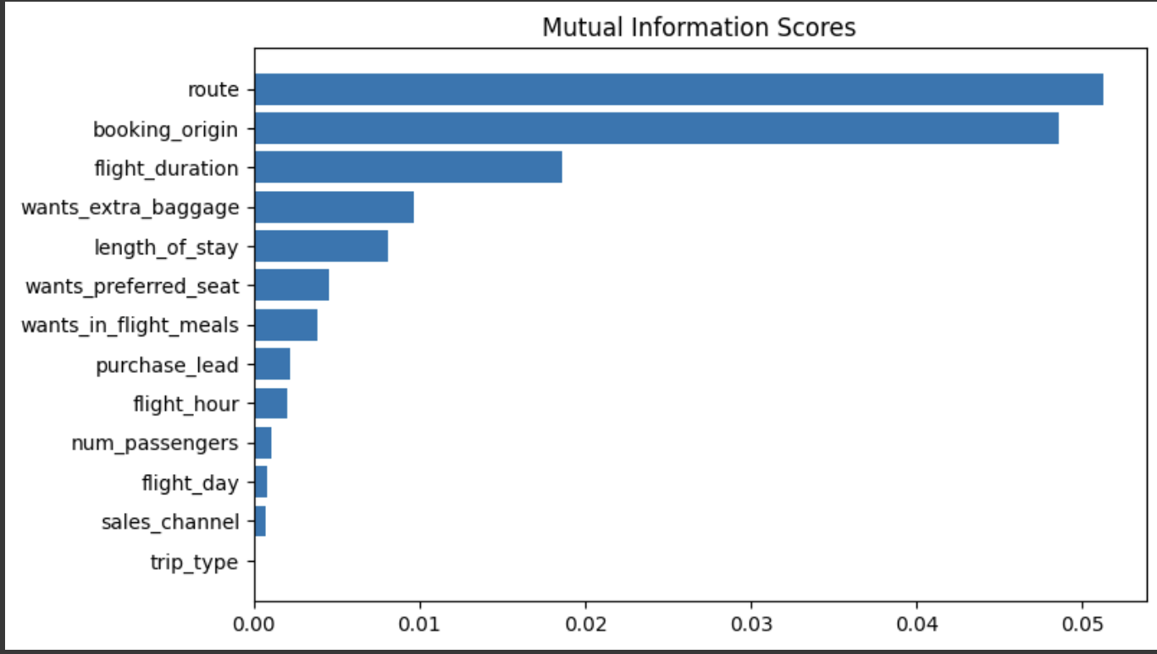
Predicting customer buying behaviour
We trained the data set with SVM and Random forest model and received
Accuracy:
SVM algorithm:85%
RandomForest algorithm:86%
route
booking_origin
flight_duration
wants_extra_baggage
length_of_stay
are the top 5 features which influence Customer buying behavior

